Slide 1

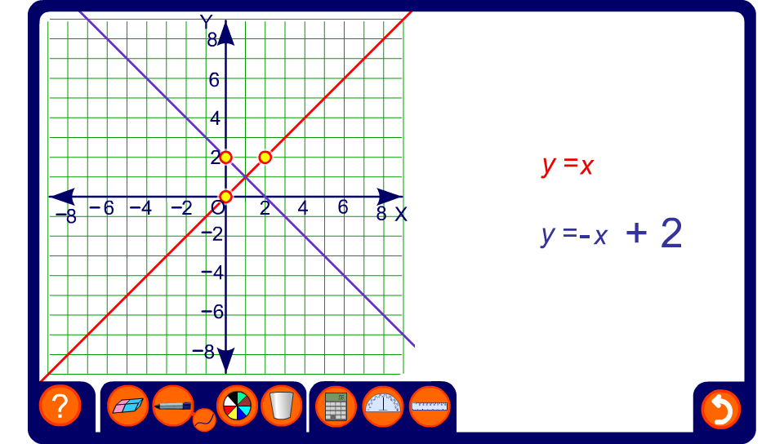


Investigating perpendicular lines

